Slide 1
Nudge Learning Retention Application
Development by Larissa Cox and Trenton Bricken
Help from Michael Greene, Chris Lorch, Heather Valli, Jolie Tingen, Justin Johnsen, and Seth Anderson

Slide 2
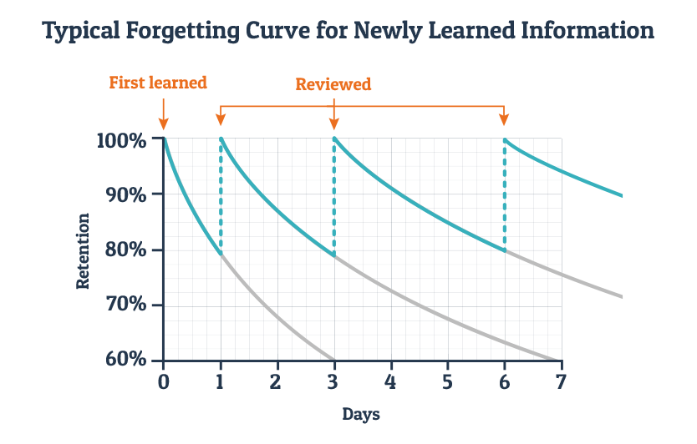
Fighting the Ebbinghaus Forgetting Curve

Slide 3

Initial Research

Slide 4
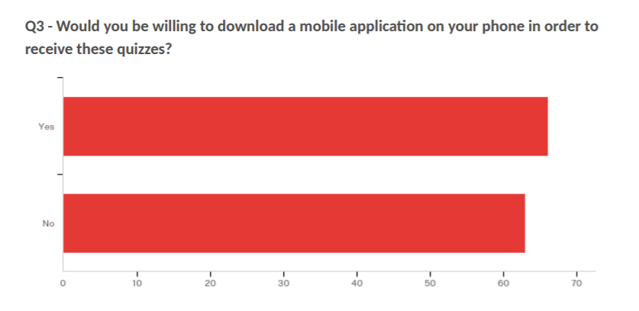
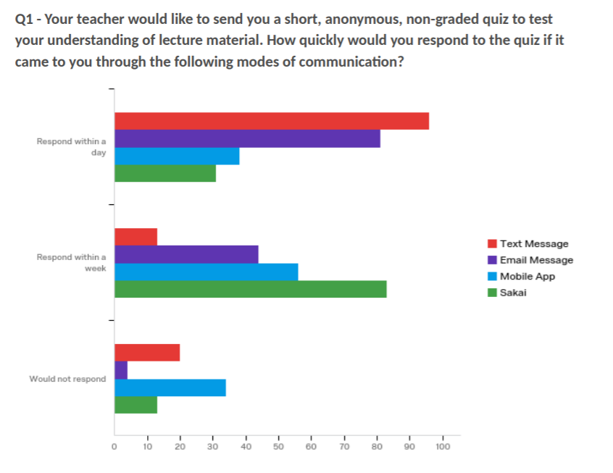
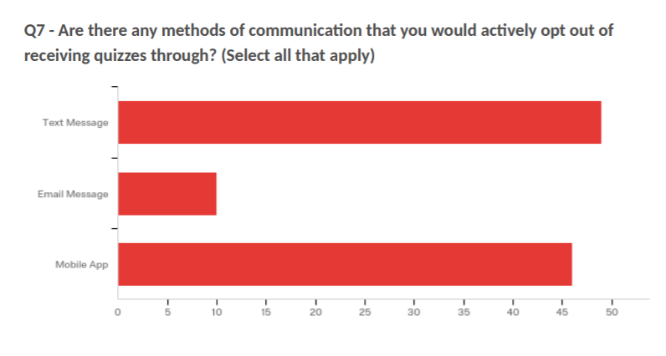
Initial Research

Slide 5



How it’s Built

Slide 6
Demo

Slide 7
User Testing

Slide 8
User Testing Feedback: The Positives
Students generally liked the workflow
Students expressed interest in using the app

Slide 9
Moving Forward from a Prototype
Great for testing and getting student feedback
Test over a longer period with real classes of students

